Slide 1
Inverse Kinematics and Particles
Grant Smith 40111906
Physics-based Animation

Slide 2
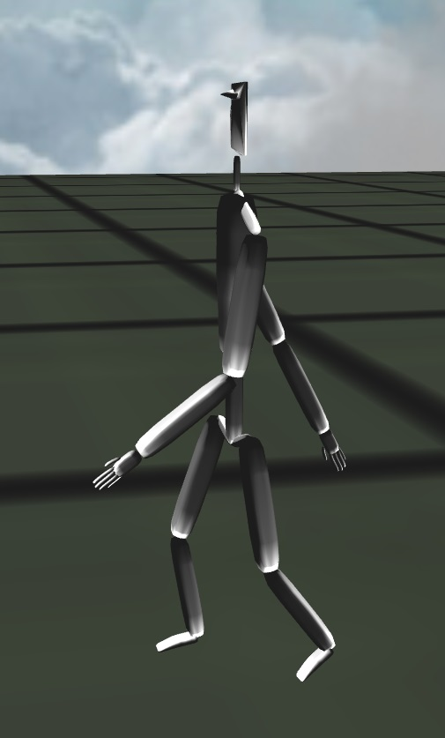
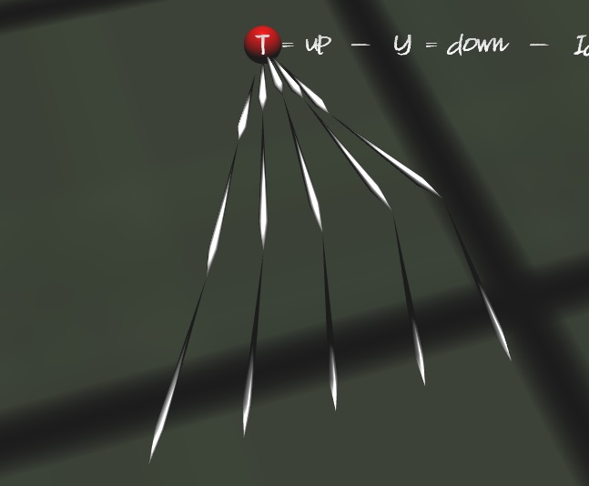
Inverse Kinematics
Implemented using the CCD method
Angle Limits
Reach Limits
Procedural Animation

Slide 3
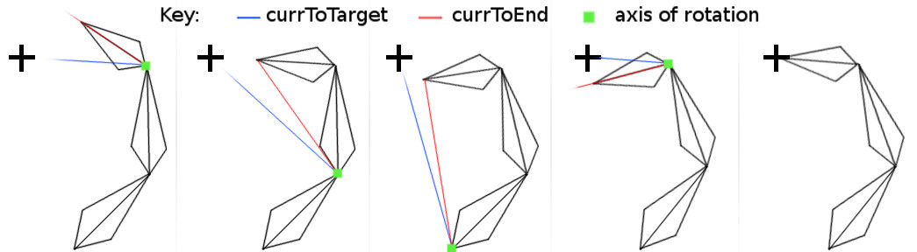
Cyclic Coordinate Descent (CCD)
Simple
Fast
Iterative
Process:
Get the axis of rotation (cross product)
Get the angle to rotate (acos + dot product)
Create a quaternion from the axis and angle
If the quaternion is within the angle limits
Rotate the link
After this is done for each link, apply the rotation from the root link down to the last child

Slide 4
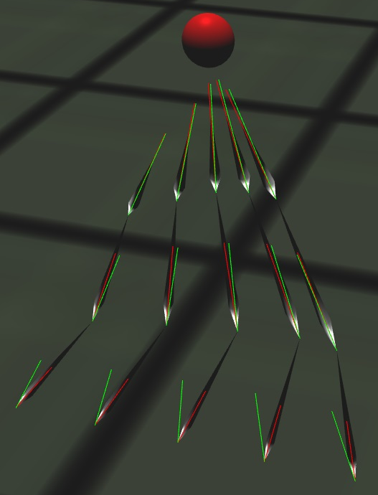
Inverse Kinematics Testing
To test the Inverse Kinematics:
Create a point to follow
Rotate that point randomly around every axis (x, y, z)
If it can reach
It should always work
If it can’t reach
It doesn’t work

Slide 5
Collision Detection
Sphere v Sphere
AABB v AABB (Axis Aligned Bounding Box)
OBB v OBB (Orientated Bounding Box)
Line v Line
Sphere v Plane
Other combinations will not be covered since they are mostly derivatives of the above

Slide 6
Sphere v Sphere
Offset vector from sphereA and sphereB
Take the magnitude of the offset
If the sum of the radii is less than the magnitude
There is an intersection
If the sum of the radii is less than the magnitude
No Intersection
Sphere A
r
offset
r
Sphere B

Slide 7
AABB v AABB
For each axis: x, y and z
Check centre[axis] of cubeA – centre[axis] of cubeB is less than
The sum of the dimension of each cube on that axis
If the check is true on each axis then there is an intersection
Centre
(x, y, z)
Dimension
(x, y, z)
cubeA
Centre
(x, y, z)
Dimension
(x, y, z)
cubeB

Slide 8
OBB v OBB
cube0.normals[0],
cube0.normals[1],
cube0.normals[2],
cube1.normals[0],
cube1.normals[1],
cube1.normals[2],
cross(cube0.normals[0], cube1.normals[0]),
cross(cube0.normals[0], cube1.normals[1]),
cross(cube0.normals[0], cube1.normals[2]),
cross(cube0.normals[1], cube1.normals[0]),
cross(cube0.normals[1], cube1.normals[1]),
cross(cube0.normals[1], cube1.normals[2]),
cross(cube0.normals[2], cube1.normals[0]),
cross(cube0.normals[2], cube1.normals[1]),
cross(cube0.normals[2], cube1.normals[2])
normalize(cube1.position - cube0.position)
Centre
(x, y, z)
Take the 3 normal of two cubes (ignoring normals that are the negative of another)
Add them to a list called ‘axes’
Take the cross of each normal from the first cube and each normal from the second cube
Add them to ‘axes’
Add the normalized offset of the cubes to the list as well ‘axes’
Get the corners of both cubes and add them to a list called ‘corners’
Dimension
(x, y, z)
Rotation
(4x4 Matrix)
3 Normals
(x, y, z)

Slide 9
OBB v OBB (cont.)
For every axis in the ‘axes’ list
Do a 1D intersection test
If at any point, the 1D intersection is false, there is no intersection = no collision
If each test returned true, pick the test that returned the lowest overlap and use the axis for that as the collision direction
1D intersection test:
Take the dot product of the axis against each corner (for both cubes)
Store the min and max value from the dot product for each cube
Calculate the longSpan = fmax(max0, max1) - fmin(min0, min1)
Calculate the sumSpan = max0 - min0 + max1 - min1
If the long span is less than or equal to the sum span, there is an overlap on the axis

Slide 10



Sphere v plane
Calculate the distance from the origin
$d_{0}= {Plane}_{normal} . {Plane}_{position}$
Calculate the distance between the sphere and the plane
$d= {Plane}_{normal} . \left({Sphere}_{position}−{Plane}_{position}\right) − d_{0}$
If $d$ <= 0 then there is an intersection
The direction of the collision is the plane’s normal
$Intersection= {Plane}_{normal} ∗d$
r
$${Sphere}_{position}$$
$$d$$
Plane_{normal}
Plane_{position}

Slide 11
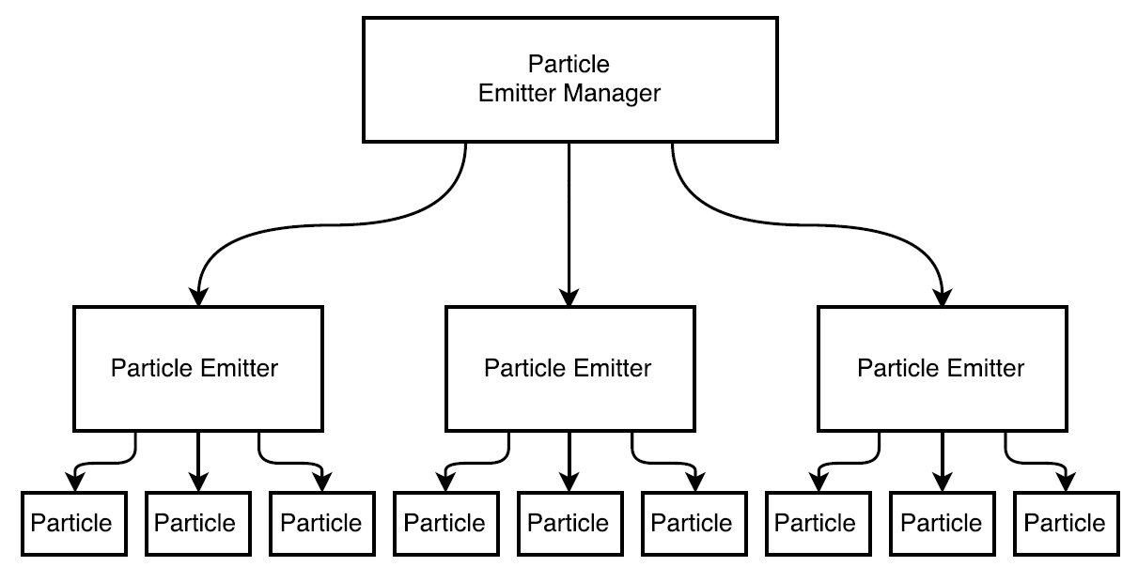
Particle System
Hierarchical:
Manager contains many emitters
Emitters contain many particles
This structure allows for:
Emitters to be easily added and removed
The entire system to be updated with ease
Better management of resources
(eg textures)

Slide 12
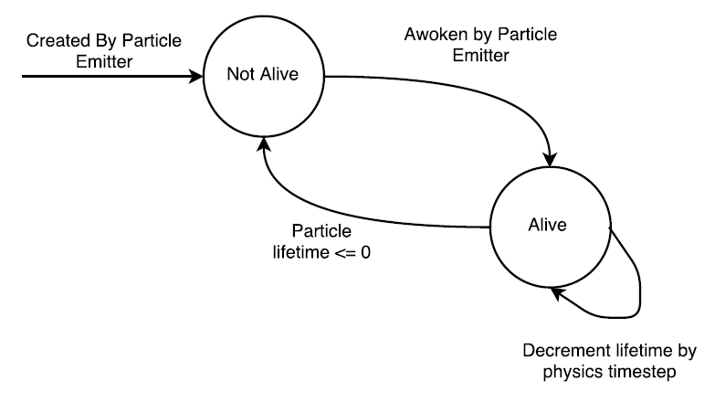
To reduce time wasted allocating and deallocating memory, each emitter has one list of particles that is not dynamic.
Instead of deallocating particles when they die, they change state, reducing the time wasted.
On creation
set the life time to an initial value and set the state (Alive).
When the life time is <= 0
Set the state (Not Alive)
Don’t update or render particles in the ‘Not Alive’ state.
Particles make use of linear dynamics to respond to collision
(managed within the Spatial Partitioning Grid)

Slide 13
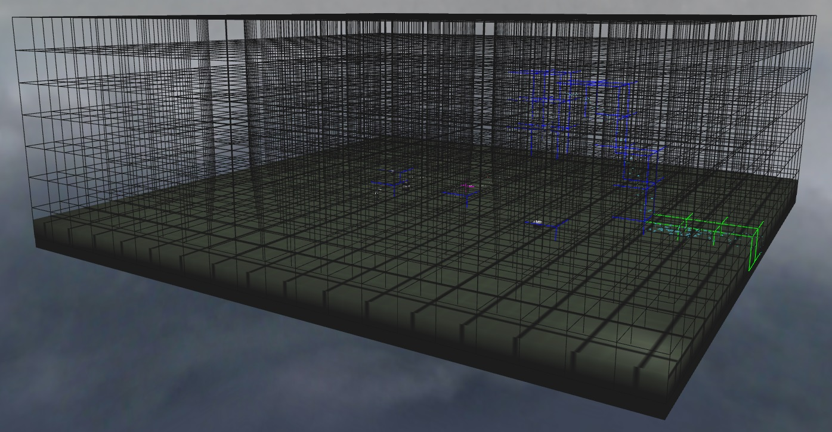
Spatial Partitioning
To improve the performance of the particles and reduce the limitations met (particle quantity), the SP grid was implemented.
SP grid:
Splits the entire scene up into small cubes within one large cube
Collision detection and response managed within cells of the grid
Takes 3D world positions and converts them to 1D array positions
The 1D positions represent a cell

Slide 14
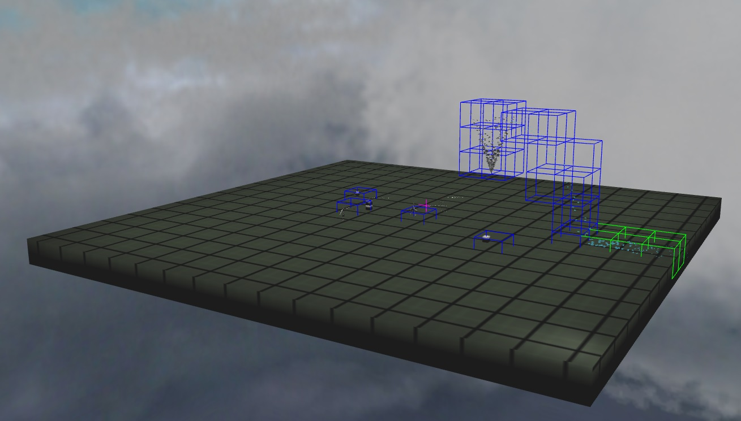
Each time a collider is updated:
Collider calls the SP grid, passing itself
The grid uses the collider’s position to determine what cells it covers
Passes the collider to relevant cells
Each cell:
Checks the collider for collisions with other colliders in that cell
If there is a collision then the corrective impulses and forces are applied
Debug rendering of the Spatial Partitioning Grid
Blue = collider called the cell but no collision checks
Green = 1 to 5 collision checks

Slide 15
Rigid Bodies – linear dynamics
Rigid bodies implemented using linear dynamics (no rotation)
Implemented for collision response and for more user interaction
User controlled rigid body
Collision response using impulses with small corrective forces
Implemented using the collider and SP grid
Collider manages the integration (using Explicit Eular)
SP grid manages the calculation of impulses and forces to correct collision

Slide 16

Rigid Bodies – Integration
Integration using the Explicit Euler method
V_{n+1} = v_{n} + α_{n}Δt <-- Velocity incremented by the acceleration relative to the time passed
S_{n+1} = S_{n} + V_{n}Δt <-- Position incremented by the velocity relative to the time passed
Acceleration is calculated using Newton’s Second Law
$f$ = ma
$α$= $\frac{f}{m}$

Slide 17

Collision Response
Impulse calculated using:
Impulse = $n ∗\left(n . \left(v_{0} −v_{1}\right)\right)∗k$
$n$ = direction of collision
$v_{0}$ = velocity of one collider
$v_{1}$ = velocity of other collider
$k$ = elasticity constant
The impulse is applied directly to the collider by the SP grid in order to correct collisions.

Slide 18
Improvements
Particle System implemented using compute shaders
Reduce load on cpu by passing it to the gpu
Self colliding Inverse Kinematics
Make the Spatial Partitioning Grid more dynamic
Adapts to the scene better (cells with different size/shape)

